Slide 1
Patient stratification and molecular mechanism identification using patient clinotypes and transcriptomics embeddings
Presenter: Zongliang Yue PhD
Mentor: Jake Chen PhD, Christopher Willey, MD/PhD
Institute: Informatics Institute, UAB

Slide 2
Molecular mechanism identification using network modeling
Advanced Network
Statistical model
Genotype
Network
Phenotype
A graph G(V; E)
Complex traits
Diabetes
Parkinson’s disease
…
GWAS loci
Gene-set
A
Genes
RNA expression
/single-cell sequencing
>20,000
C
B
Cancer
Glioblastoma
Leukemia
…
D
Gene expression
Gene expression
miRNA expression
Fisher’s test/t-test
Protein expression
A
Resistance
Drug resistance
Radiation resistance
C
100~1000
Epigenetic profile
D
B
Genome data translation study through network modeling
Notes:
First question: why does the molecular network matters in the complex disease?
The complex disease is undergoing considerable genes that are small in effect which makes the functional interpretation of the genes difficult.
High levels of data variability can exist
Statistical significance <> biological significance
False negative –insignificantly expressed but important in the functional coordination.
Systems biology analysis to reveal and add back those genes that trivial in expression but critical in function.
Phenotypes in the complex disease
Network:
PPI -- HAPPI: high-throughput experimental PPIs (from HPRD -- Human Protein Reference Database and BIND -- The Biomolecular Interaction Network Database), literature-curated PPIs (from BIND), text-mined PPIs (from STRING --Search Tool for the Retrieval of Interacting Genes/Proteins), and computational predicted PPIs (from STRING and OPHID -- Online Predicted Human Interaction Database)
Gene regulation: transcriptional control (whether and how much a gene is transcribed into mRNA), translational control (whether and how much an mRNA is translated into protein) or post-translational control (whether the protein is in an active or inactive form, and whether the protein is stable or degraded)
Heritability: the fraction of total variation in a trait that is due to variation in genes
Complex diseases involve a sequence of genetic disorders in disease progression with dysfunctions in multiple systems, including DNA repair, apoptotic and immune functions
The polygenic inheritance of complex diseases makes the meristic traits being controlled by numbers of genetic loci, which also be referred to as genetic heterogeneity
The role of molecular network is to bridge the gap in understanding the tranlation from genotype to phenotype.

Slide 3


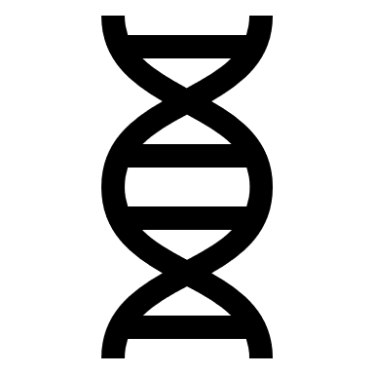



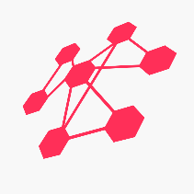
The translational bioinformatics tools and database to advance precision medicine in brain cancer
1
2
Enriched PAGs
+
Enriched PAG-to-PAG network
GETC candidates
Latent Space of the Most Biological Relevant candidates + PPIs
Genetic mutations
Differentially Expressed Genes (RNA-seq)
Glioblastoma Drug Target (DrugBank)
WINNER
WINNER
Clinical data (subtype and survival)
3
3
4
4
5
WIPER
WIPER
Most Biologically Relevant PPIs
Most Biologically Relevant pathways
The roadmap
Notes:
New disease biology hypothesis
Robust biomarkers
New therapeutic targets
New precision medicine recommendations

Slide 4
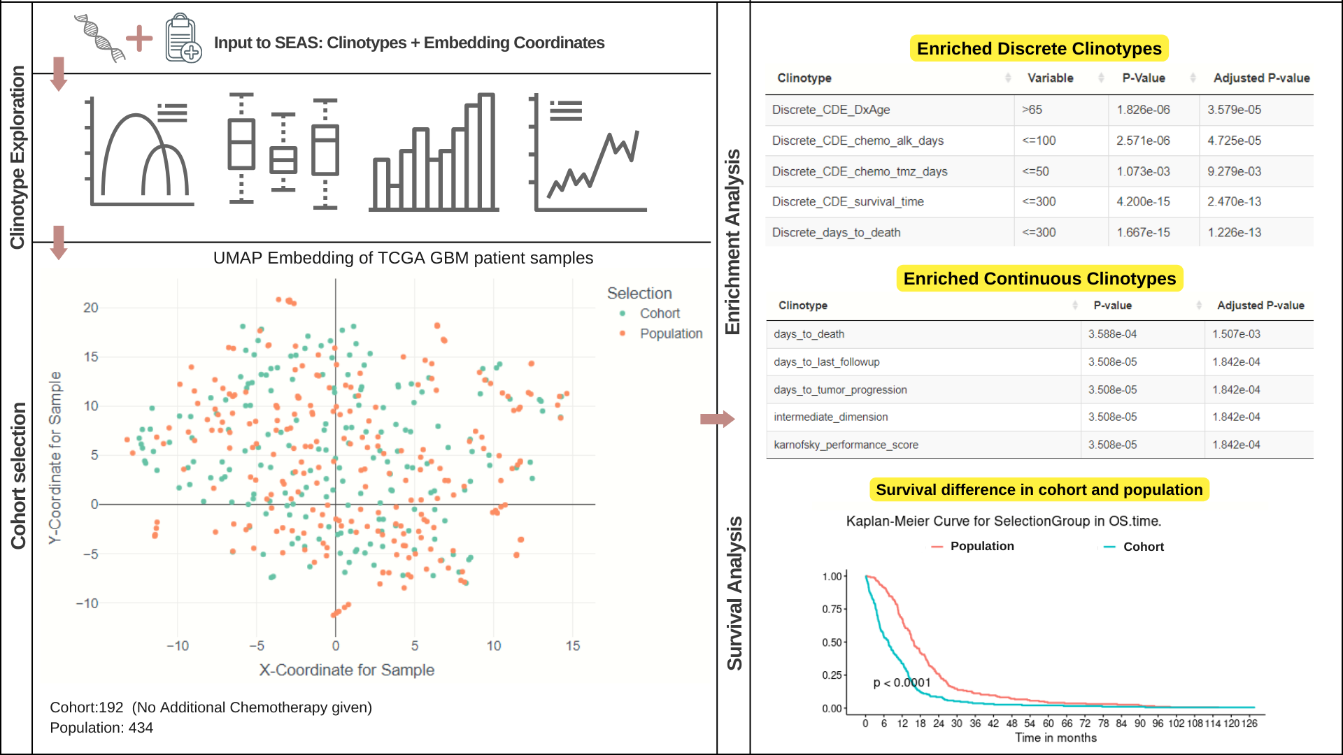
1. Statistical Enrichment Analysis of Samples (SEAS)
Nguyen et al. in Front. Big Data,2021
Notes:
Statistical Enrichment Analysis of Samples (SEAS) is a tool to find which clinotypes (clinical attributes) are enriched within a sample subset

Slide 5
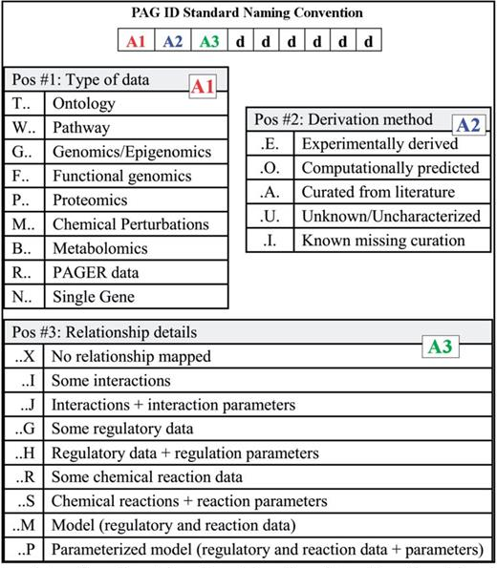
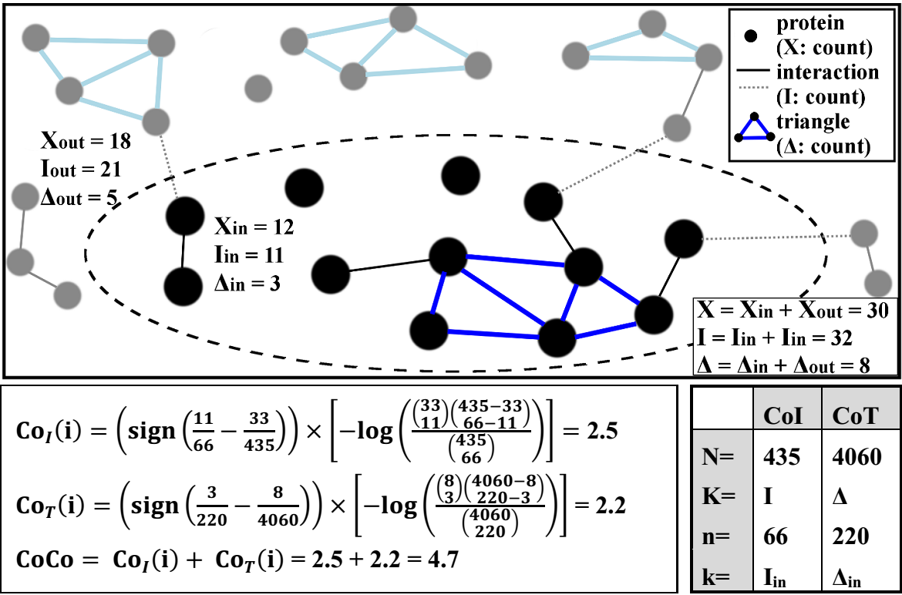
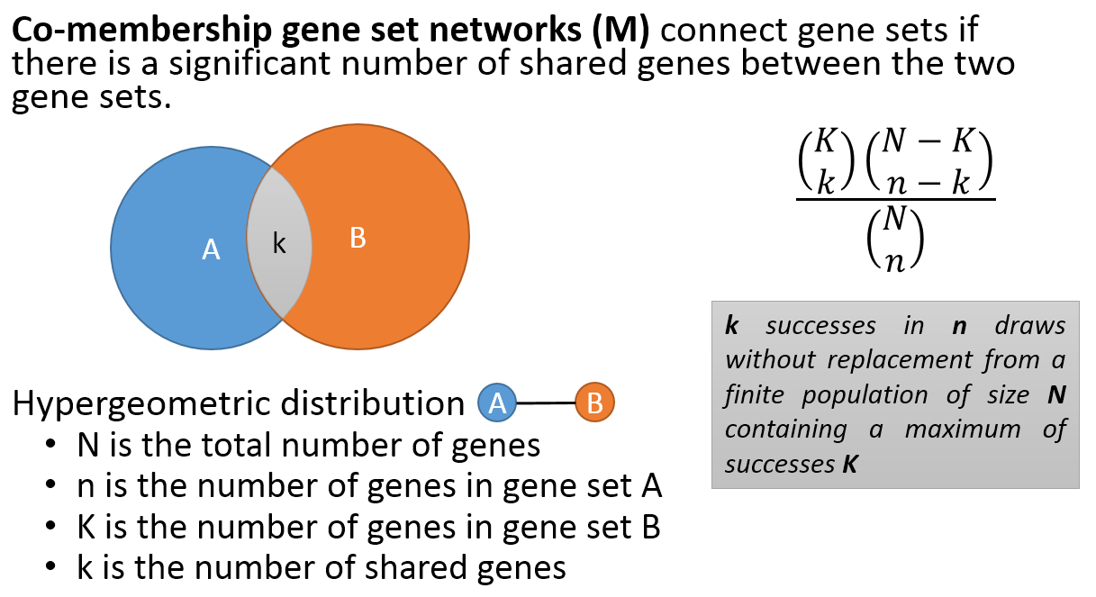
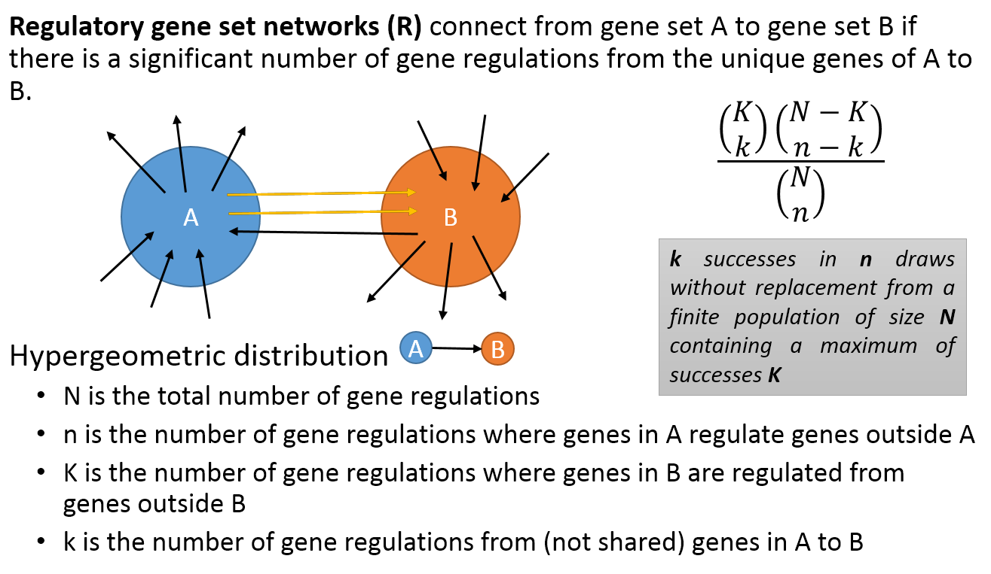
2. PAGER – a database of curated Pathways, Annotated lists and Gene signatures
1. PAG – “Super Gene Set” standardized naming convention.
2. Data quality
Data coverage in PAGER 2.0
3. PAG-PAG relationship
Category | Count
Human genes | 29,977
Gene-to-gene pairs | 601,164
protein-protein interactions | 579,037
gene regulations | 22,127
PAGs | 84,282
sPAG (n=1) | 27,206
mPAG (n>1) | 57,076
with CoCo scores <1 | 42,048
with CoCo scores >=1 | 15,028
PAG-to-PAG pairs | 7,538,275
m-type (significant) | 7,418,174
r-type (significant) | 120,101
sPAG to mPAG | 28,744
mPAG to mPAG | 83,741
mPAG to sPAG | 4,613
Yue et al. in Nucleic Acids Research , Vol 46, Issue D1, 2018, Pp D668 D676, https://doi.org/10.1093/nar/gkx1040
Notes:
PAG data source, curation and quality control
P-type PAG: a connected set of molecules (genes/ proteins/ metabolites), among which some detail of curated mechanism of actions.
A-type PAG: a curated list of genes/proteins identified from a specific biological context.
G-type PAG: a list of genes/proteins derived from any given high throughput experiment.
Defining biological meaning of PAGs – CoCo score calculation. The HAPPI-2 database was used to calculate the Cohesion of protein-protein Interaction (CoI) and the Cohesion of Triangles (CoT) score based on the hypergeometric cumulative distribution function (CDF) value using the formula.

Slide 6
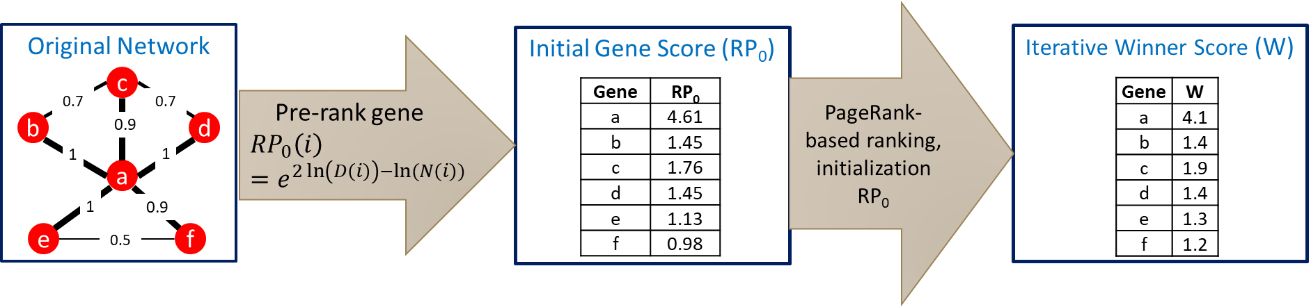
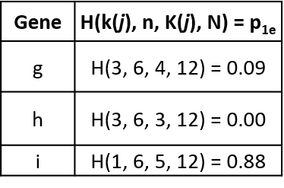
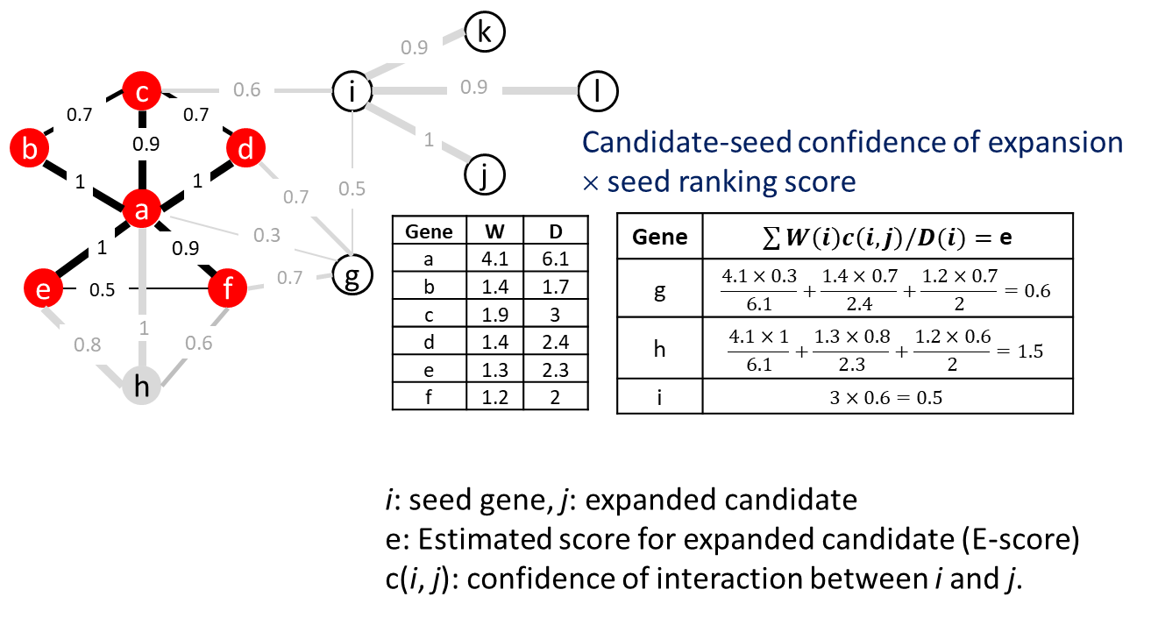
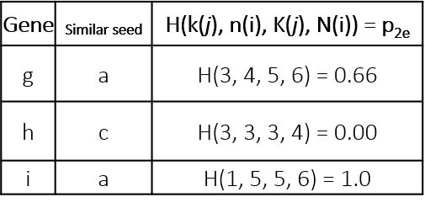
3. Developing Gene Prioritization Algorithm in Network Analysis
WINNER: Weighted in-network Node Expansion and Ranking
1. How likely a gene interact with the seeded genes compared to its global interaction
‘testing sample’ ‘population’
k(j): # seeded interactors K(j): # interactors (global)
n: # seeded genes N: # the whole genes
2. How likely a gene interact with the seeded genes
compared to the most similar seeded (hub) gene
i: seeded gene j: seed-neighbor genes
k(j): # seeded interactors K(j): # interactors (local)
n(i): # seeded gemnes N(i): # the genes (local)
Manuscript being prepared
Notes:
Intend to evaluate how important genes and more important is how to evaluate the neighborhood in the network extension?
In this work called WINNER, we
This method based on seed gene weights estimated by Pagerank and expanded gene weights estimated by the sum of weighted neighbor information flow.
pageRank is same to Google Search to rank web pages in their search engine results. PageRank was named after Larry Page)
The expanded genes weights are use the neighbor weighted multiply the normalized outflow interaction weights.
We calculated the scores, but do we accept expanded gene scores as significant or not.

Slide 7
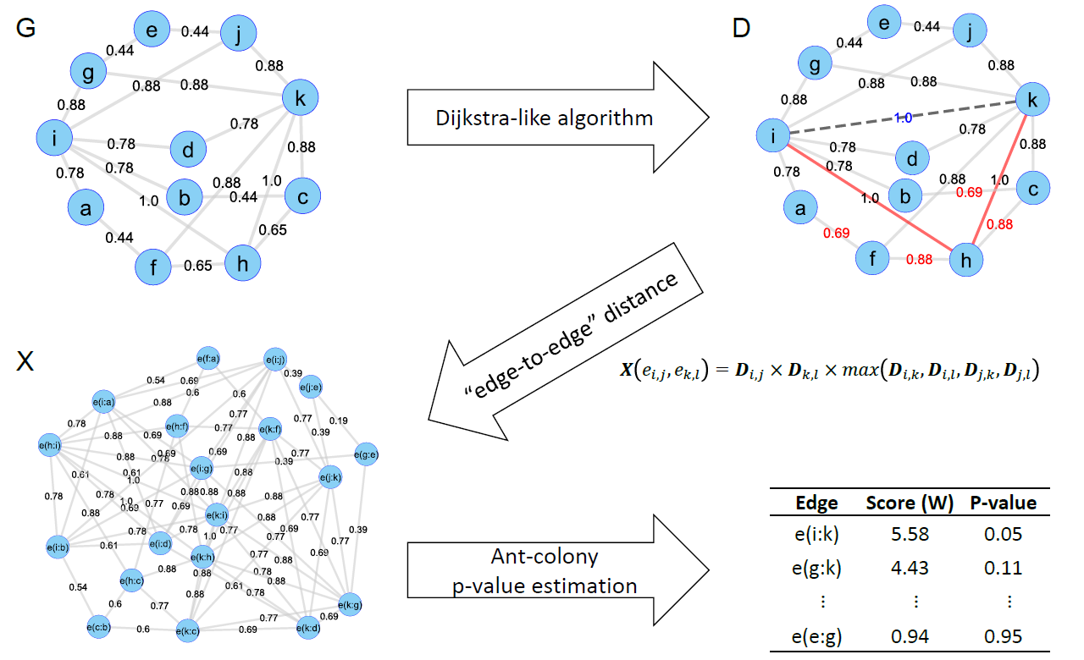
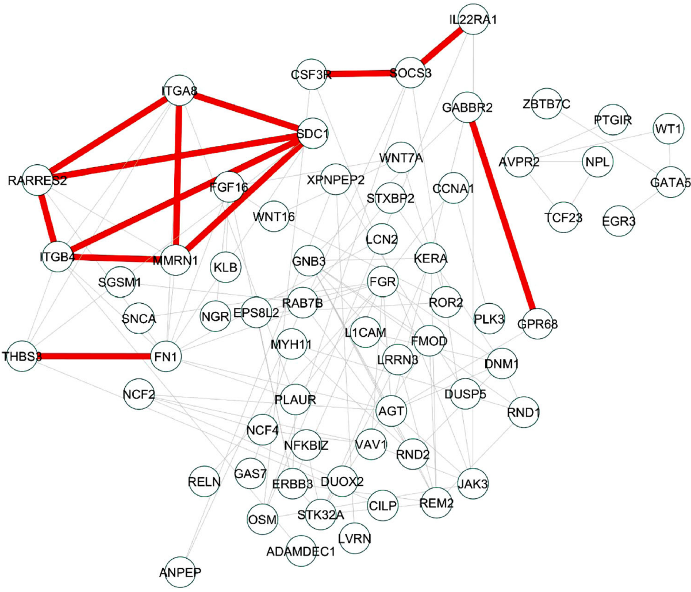

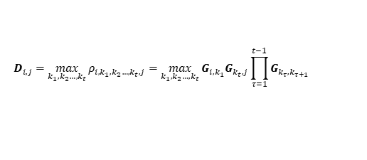
4. Developing Gene-gene Interactions Prioritization Algorithm in Network Analysis
WIPER: Weighted in-Path Edge Ranking for biomolecular association networks
WIPER
$$D_{i,j}=\max_{k_{1},k_{2}…,k_{t}}{ρ_{i,k_{1},k_{2}…,k_{t},j}}=\max_{k_{1},k_{2}…,k_{t}}{G_{i,k_{1}}G_{k_{t},j}\prod_{τ=1}^{t−1}{G_{k_{τ}{,k}_{τ+1}}} }$$
$$W_{s}\left(e_{i,j}\right)=W_{s−1}\left(e_{i,j}\right)−σ\left(W_{s−1}\left(e_{i,j}\right)\sum_{Γ_{i.j}}{∆\left(e_{i,j},e_{k,l}\right)}−\sum_{Γ_{i.j}}{∆\left(e_{k,l},e_{i,j}\right)W_{s−1}\left(e_{k,l}\right)}\right)$$
The WIPER algorithm—an illustration how it works. Here, we use the graph visualization to represent the content of each matrix. In the D-matrix, the red number representing edges whose optimal path (with maximum length of 2) value is different from the original edge weight, and the edge e_{i,k}, with path value = 1, is considered the novel edge. We also highlight two edges e_{i,h} and e_{h,k}, which are the major reasons for the highlights.
Detail
Yue et al. WIPER: Quantitative Biology 2019, 7(4): 313 326://doi.org/10.1007/s40484-019-0180-y
Notes:
Traversal path conquers the current path better weight by multiplying the all the path weights in the path.
Four endpoints.
Information outflow - Information inflow
WIPER can help discover novel paths (highlighted in red) among genes differentially expressed among postanal pig hearts. The nodes represent the differentially expressed genes (DEGs) generated from the cardiac transcriptome profiles of age-matched (28 days old) postnatal pigs which underwent myocardial infarction at postnatal day 1 and 14. The edges represent the protein-protein interactions of the DEGs using STRING database with quality no less than 0.75.

Slide 8
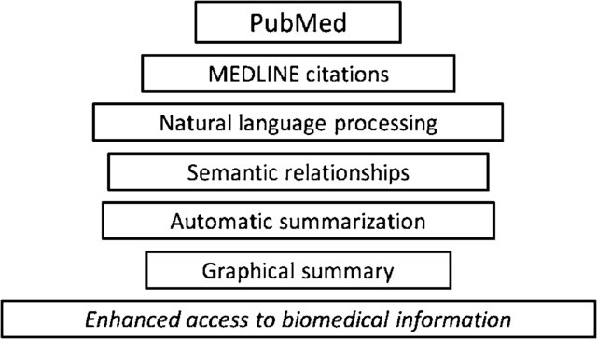
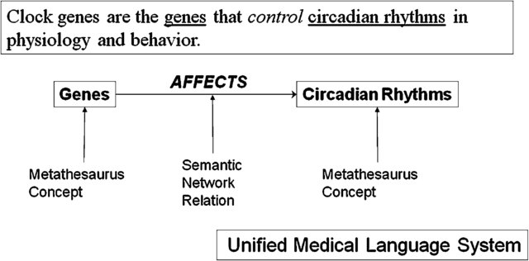

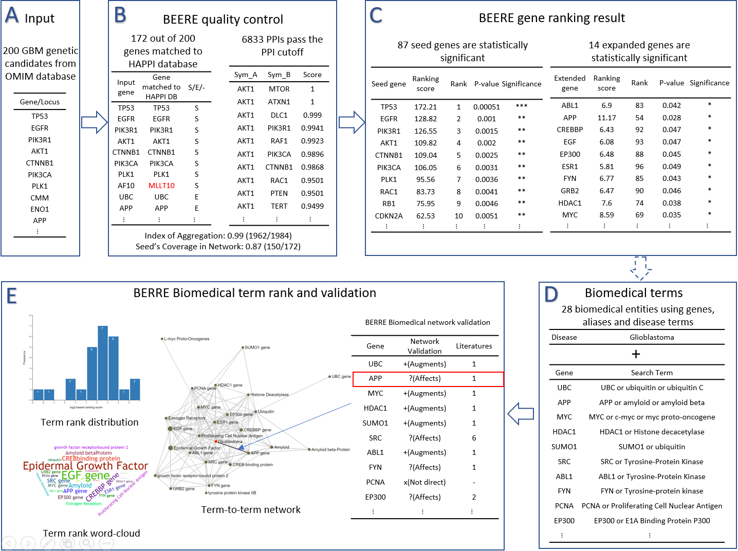
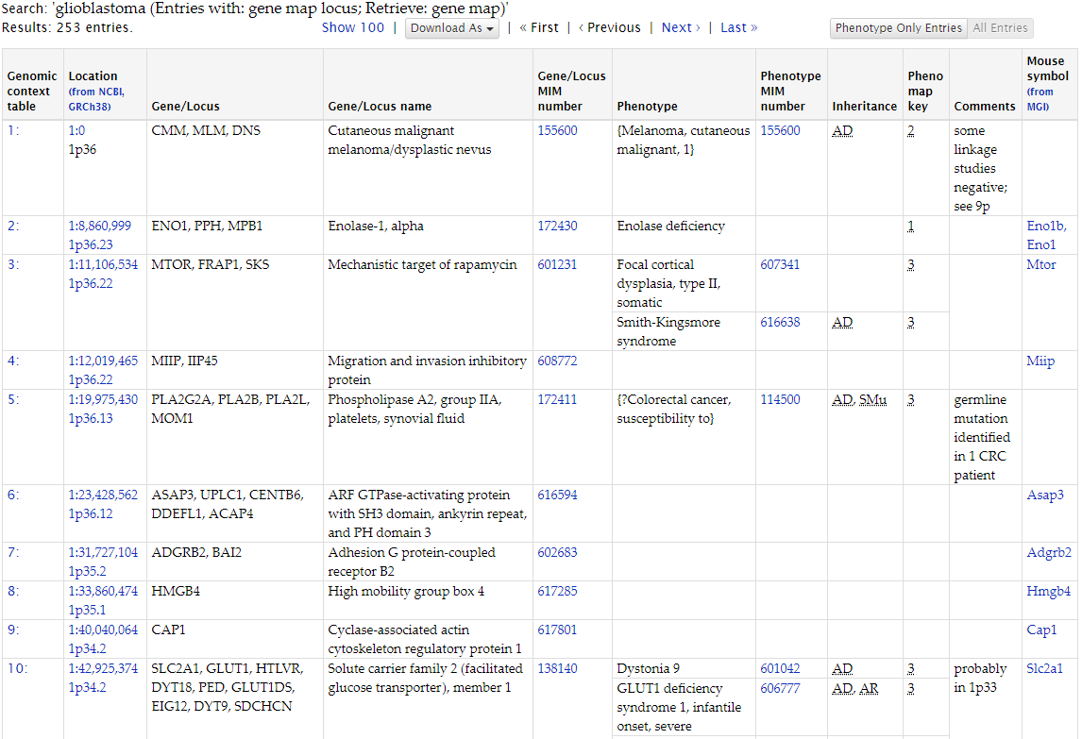
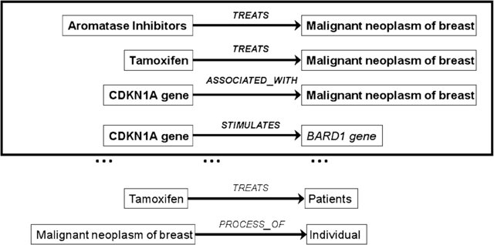
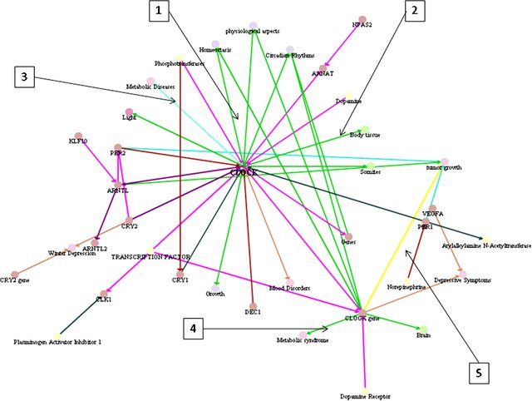
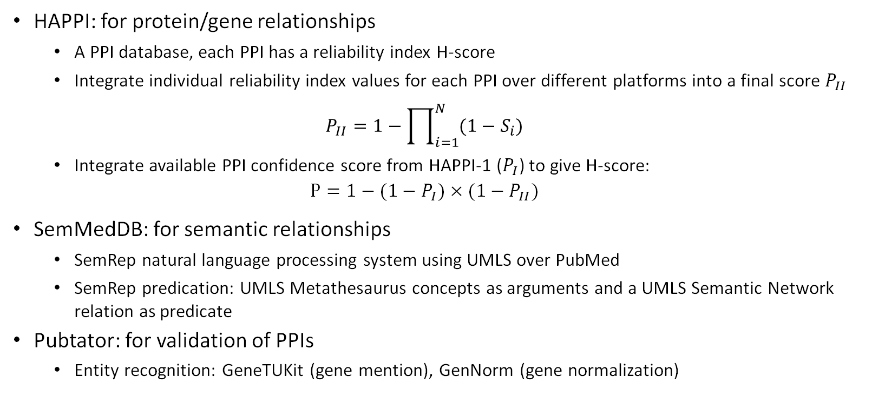
5. Developing Semantic Network of Biomedical Entities using BEERE
BEERE data processing using nature language procession
Data source
1. MEDLINE processing
2. Predication extraction
Conjunction analysis: Glioblastoma (GBM) study
HAPPI: for protein/gene relationships
A PPI database, each PPI has a reliability index H-score
Integrate individual reliability index values for each PPI over different platforms into a final score $P_{II}$
$$P_{II}=1−\prod_{i=1}^{N}{(1−S_{i})}$$
Integrate available PPI confidence score from HAPPI-1 ($P_{I}$) to give H-score:
$$P=1−(1−P_{I})×(1−P_{II})$$
SemMedDB: for semantic relationships
SemRep natural language processing system using UMLS over PubMed
SemRep predication: UMLS Metathesaurus concepts as arguments and a UMLS Semantic Network relation as predicate
Pubtator: for validation of PPIs
Entity recognition: GeneTUKit (gene mention), GenNorm (gene normalization)
2,922,202 quality-ranked PPIs
19,836,578 predications
7,677,876 gene-to-PMID relationships
3. Predication filtering/ranking
4. Concept Network Construction
96,363,098 predication-to-PMID citations
Yue et al. BEERE:, Nucleic Acids Research, 2019
Notes:
Semantic MEDLINE processing.
Example predication extracted from text by SemRep.
SemRep predications extracted from text on breast cancer. Predications outside the box are eliminated by automatic summarization.
Semantic MEDLINE graph showing SemRep predications extracted from MEDLINE citations retrieved with the PubMed query " clock gene “.

Slide 9
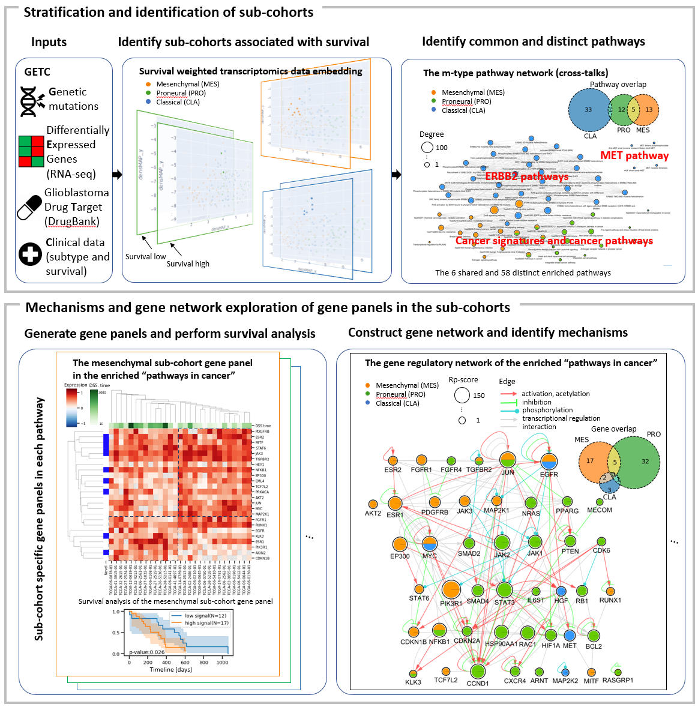
Overview of the GBM TCGA data exploration
Yue et al. Cancer patient stratification and molecular mechanism identification using patient clinotypes and transcriptomics embeddings, ECCB 2022

Slide 10
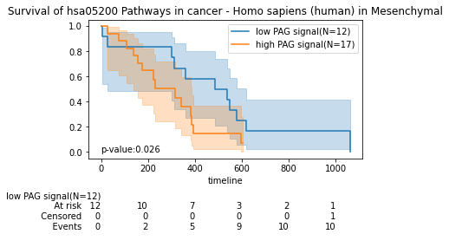
Gene fusion
CNA
Methylation
RNA-seq
Microbiome
*

Slide 11
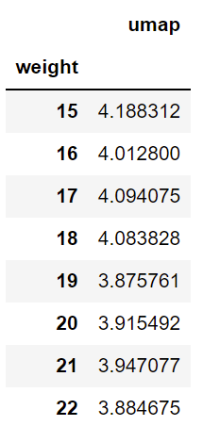
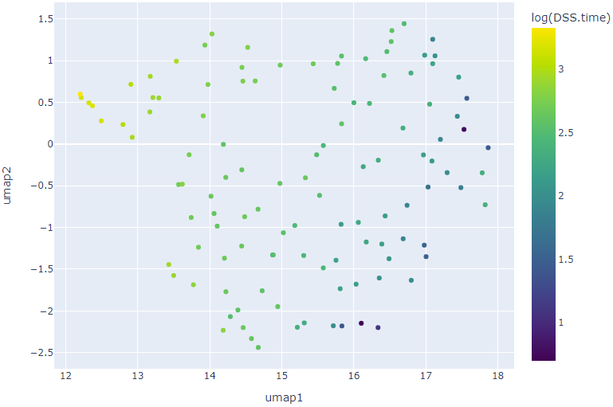
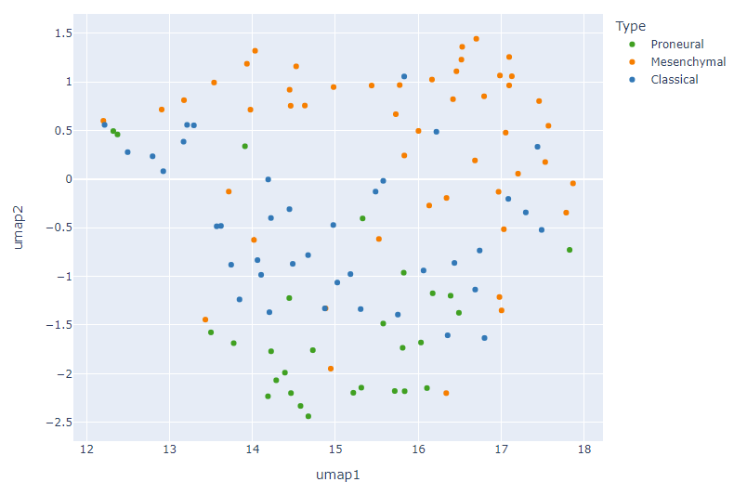
ISMD

Slide 12
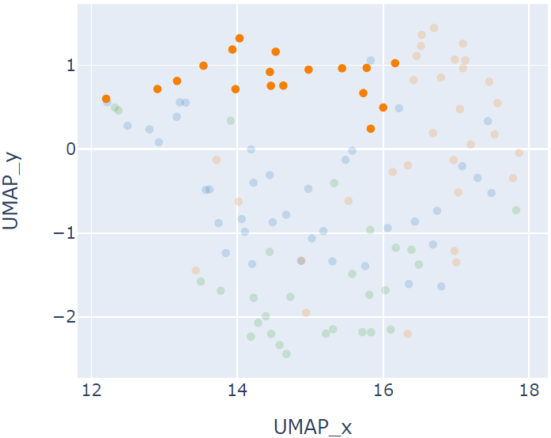
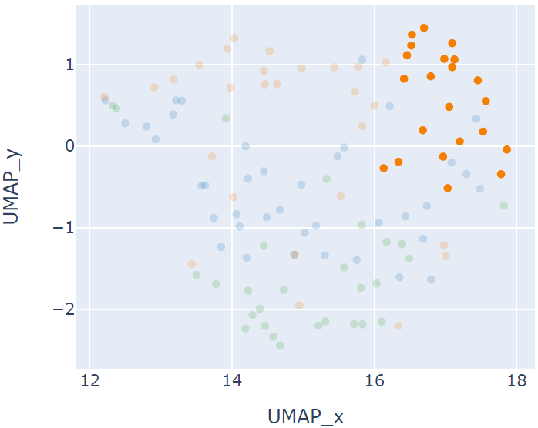
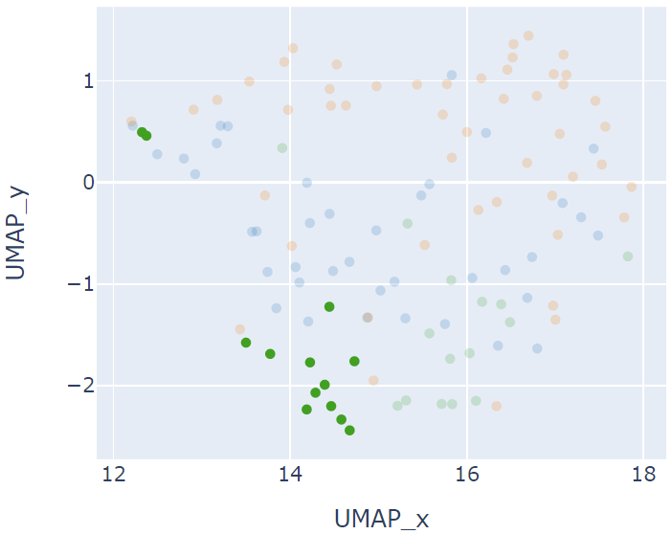
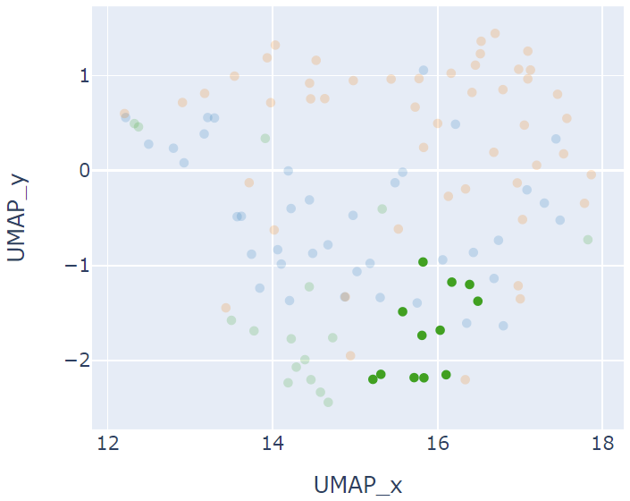
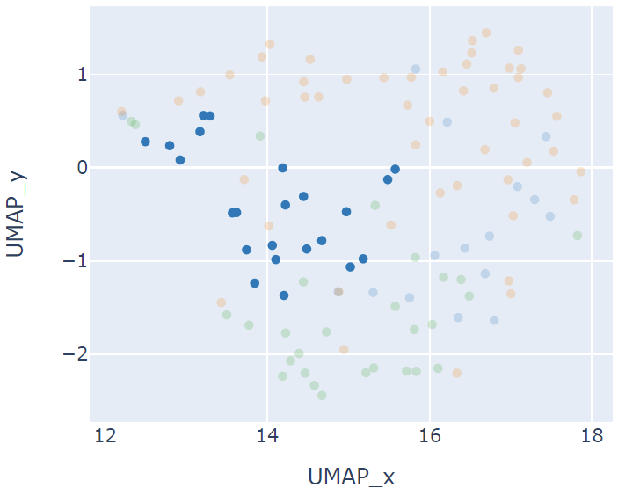
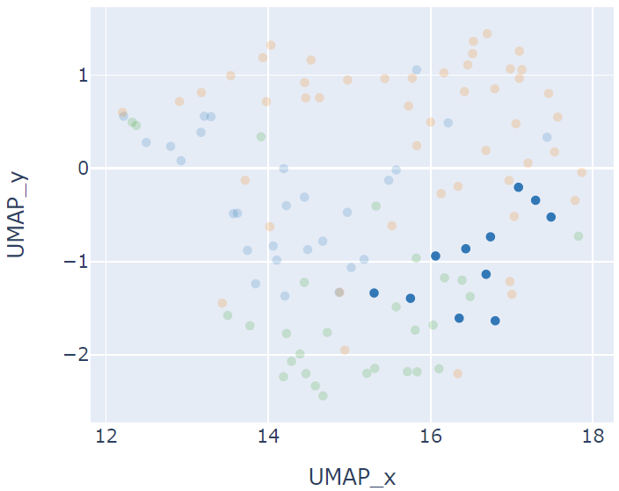
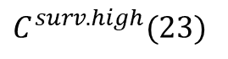
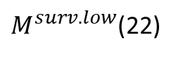
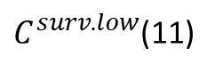
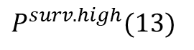
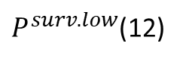
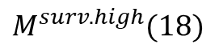
$M^{surv.high}(18)$
$M^{surv.low}$(22)
$P^{surv.high}(13)$
$P^{surv.low}$(12)
$C^{surv.high}(23)$
$C^{surv.low}$(11)

Slide 13
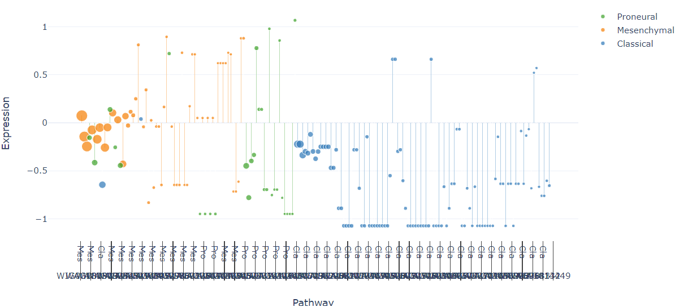
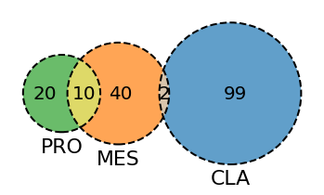
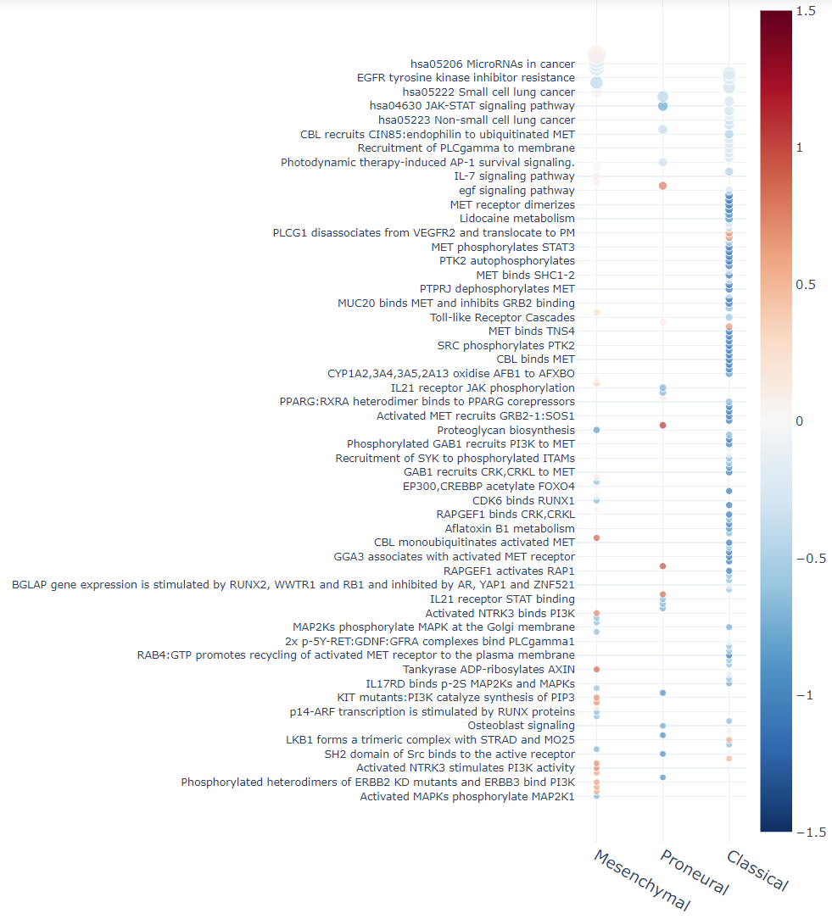
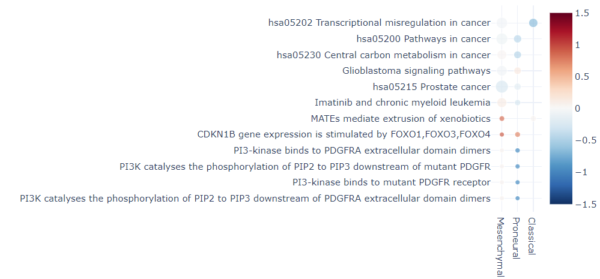
Pathway exploration among the classical, mesenchymal, and proneural
Pathway overlap

Slide 14
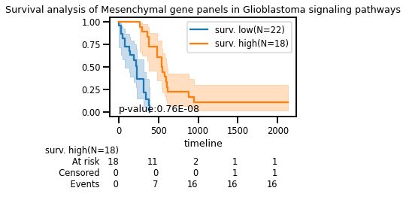
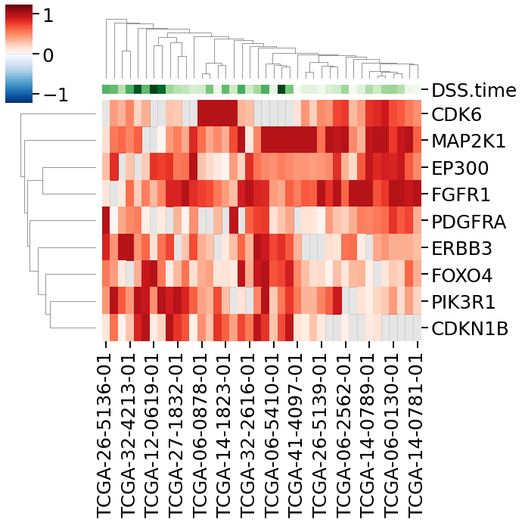
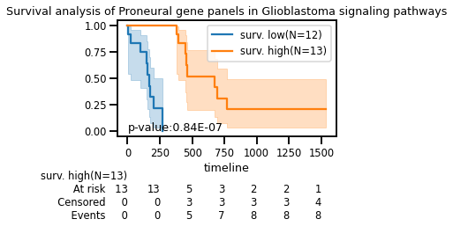
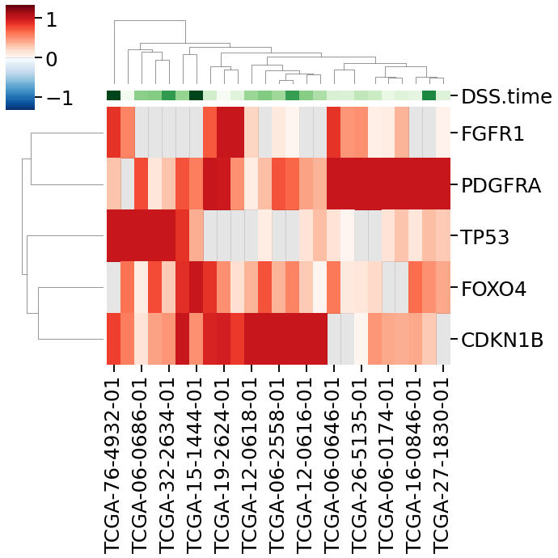
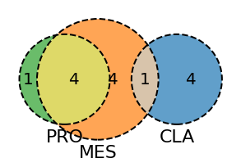
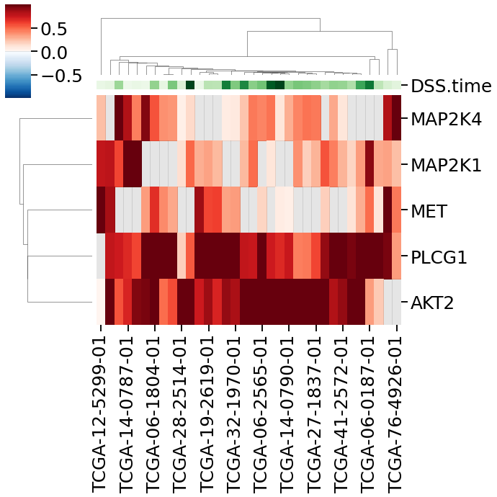
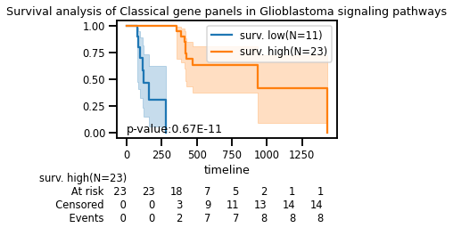
Gene overlap
https://www.ncbi.nlm.nih.gov/pmc/articles/PMC3278219/

Slide 15
GETC candidates
Genetics mutation genes: 540 genes from 33,467 mutation entries
Differentially expressed genes: 331 genes
Drugbank GBM’s drug targets: 75 targets of 17 drugs (51 GBM drugs)
Union set: 911 genes
Clinical: disease specific survival – DSS (days)
116 samples (classical 39, mesenchymal 49, and probeural 28)
Notes:
88+28

Slide 16
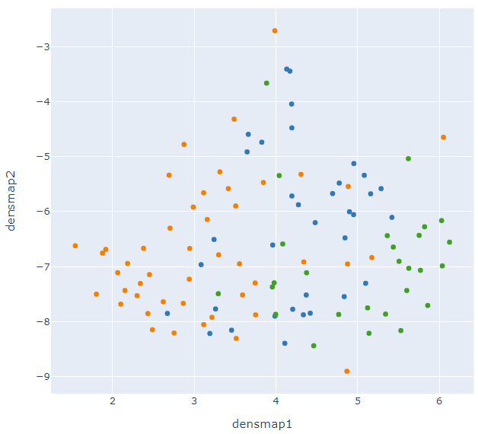


Stratification of the molecular subtype specific survival sub-cohorts
high
low
The 2D projections of expression and weighted disease specific weighted (18.5) survival (DSS.time) embeddings
Notes:
https://www.ncbi.nlm.nih.gov/pubmed/33681822
https://dx.doi.org/10.1016/j.ccell.2017.06.003
https://www.sciencedirect.com/science/article/pii/S0092867422005360?dgcid=coauthor

Slide 17















$M^{surv.high}(9)$
$M^{surv.low}$(20)
9 high vs 20 low, 120 DEGs, 78 pathways
$P^{surv.high}(2)$
$P^{surv.low}$(16)
2 high vs 16 low, 183 DEGs, 160 pathways
$C^{surv.high}(7)$
$C^{surv.low}$(7)
7 high vs 7 low, 64 DEGs, 93 pathways

Slide 18




Pathway exploration among the classical, mesenchymal, and proneural
Pathway overlap
The overall view of the enriched pathways across the three subtypes
The 6 common enriched pathways across at least two subtypes
The 58 distinct enriched pathways in each specific subtype 14 has been validated using literature for subtype specific

Slide 19

PAG-to-PAG network and the shared pathways in the three molecular subtypes
Degree
100
…
Cancer target MET
1
ERBB2 pathways
Cancer signatures and cancer pathways

Slide 20








hsa05200 Pathways in cancer - Homo sapiens (human)
Gene overlap
Common enriched pathways across at least two subtypes
*
**
*
The gene panel signals are different in each subtype, and they are joined with survivals

Slide 21



Gene regulatory network of “pathways in cancer” and the share
hsa05200 Pathways in cancer - Homo sapiens (human)
WINNER Rp-score
WIPER score
150
17
Lvl 1
…
…
1
1
Edge
Lvl 2
activation, acetylation
inhibition
phosphorylation
Lvl 3
transcriptional regulation
interaction
Lvl 4
Lvl 5
Gene panel (24 genes) of the mesenchymal subcohort
Gene panel (38 genes) of the proneural subcohort
Gene panel (6 genes) of the classical subcohort
Lvl 6
HSP90AA1 JAK2, proneural https://pubmed.ncbi.nlm.nih.gov/24500492/
NFKB1, proneural https://pubmed.ncbi.nlm.nih.gov/24500492/
Notes:
Super pathway? Merge additional pathways in the network

Slide 22


WIPER ranking of PPIs/gene-regulatory relationships in a network of glioblastoma-related genes
Size
(RDS score)
…
0.6
35
shape
Gene or related term
Disease
WIPER
Top 10 WIPER ranked edges
Implicated genes
Edge | W[100] | Rank | p-value
STAT3:JUN | 16.82 | 1 | 0.009174
JUN:CCND1 | 16.3 | 2 | 0.018519
MYC:JUN | 15.8 | 3 | 0.028037
JUN:MYC | 15.8 | 3 | 0.028302
MYC:CCND1 | 15.77 | 5 | 0.047619
STAT3:MYC | 15.75 | 6 | 0.057692
MYC:STAT3 | 15.75 | 6 | 0.058252
STAT3:CCND1 | 15.73 | 8 | 0.078431
CCND1:STAT3 | 15.73 | 8 | 0.079208
JUN:ESR1 | 14.15 | 10 | 0.1
ESR1:JUN | 14.15 | 10 | 0.10101
Gene Symbol | Full name or alias
STAT3 | signal transducer
JUN | proto-oncogene
MYC | oncogene
CCND1 | cyclin D1
ESR1 | estrogen receptor
BEERE semantic network for the implicated genes
Notes:
WIPER ranking of PPIs/gene-regulatory relationships in a network of glioblastoma-related genes
WIPER ranking and top ranked edge validation using BEERE

Slide 23

Our tools and repos
Codes and repos: https://github.com/aimed-lab
1.SEAS: http://discovery.informatics.uab.edu/SEAS/
2.PAGER: http://discovery.informatics.uab.edu/PAGER/, PAGER Web APP: https://aimed-lab.shinyapps.io/PAGERwebapp/
3.WINNER: http://discovery.informatics.uab.edu/WINNER/
4.WIPER: http://discovery.informatics.uab.edu/WIPER/
5.BEERE: http://discovery.informatics.uab.edu/BEERE/

Slide 24
Acknowledges
The AI.Med Lab
Jake Chen, PhD
Thanh Nguyen, PhD
Ehsan Saghapour, PhD
Rahul Sharma, PhD
Samuel Bharti
Nishant Batra
Zhandos Sembay
UAB Informatics Institute
Jim Cimino, MD
Amy Wang, MD
Jelai Wang
Matt Wyatt
Geoff Gordon
Nafisa Ajala
U54TR002731
U01CA223976
R01AI134023
R01AR073850
UAB School of Medicine
Robert Welner, PhD
Christopher Willey, MD/PhD
Jay Zhang, MD/PhD
Anita Hjelmeland, PhD

Slide 25






The genes and enriched pathways of the global survival high vs low (background)
31 high vs 77 low samples, 102 DEGs and 144 pathways
102/838 genes
${Global}^{surv.high}(31)$
${Global}^{surv.low}(77)$
Notes:
logFC 0.4 –log2(p.value) 4.3

Slide 26








The PAG-to-PAG network of the global survival high vs low (background)
4114 m-type relationships, 7 clusters

Slide 27



The genes and enriched pathways of the mesenchymal survival high vs low
9 high vs 20 low, 120 DEGs, 78 pathways
120/838 genes
$M^{surv.high}(N=9)$
$M^{surv.low}$(N=20)
Notes:
logFC 0.4 –log2(p.value) 4.3 similarity 0.05

Slide 28












The PAG-to-PAG network of the mesenchymal survival high vs low
817 m-type relationships, 11 clusters

Slide 29



The genes and enriched pathways of the proneural survival high vs low
2 high vs 16 low, 183 DEGs, 160 pathways
183/838 genes
$P^{surv.high}(2)$
$P^{surv.low}$(N16)
Notes:
logFC 1 –log2(p.value) 4.3, 160 PAGs similarity 0.05

Slide 30








The PAG-to-PAG network of the proneural survival high vs low
4718 m-type relationships, 7 clusters

Slide 31


The genes and enriched pathways of the classical survival high vs low
7 high vs 7 low, 64 DEGs, 93 pathways
64/838 genes
$C^{surv.high}(7)$
$C^{surv.low}$(7)
Notes:
logFC 0.3 –log2(p.value) 4.3, similarity 0.05

Slide 32







The PAG-to-PAG network of the classical survival high vs low
2020 m-type relationships, 6 clusters

Slide 33
The 58 distinct enriched pathways in each specific subtype

Slide 34



hsa05200 Pathways in cancer - Homo sapiens (human)
Gene panel = subtype specific DEGs ∩ pathway members
Gene panel (24 genes) of the mesenchymal subcohort
Notes:
15 vs 9
Expansion r-type

Slide 35
hsa05200 Pathways in cancer - Homo sapiens (human)
Gene panel (38 genes) of the proneural subcohort
Notes:
13 vs 25

Slide 36
hsa05200 Pathways in cancer - Homo sapiens (human)
Gene panel (6 genes) of the classical subcohort
Notes:
5 VS 1

Slide 37



5. A Distance-bounded Energy-field Minimization Algorithm to Model the Layout of Biomolecular Networks – cont.
Topological modeling:
The quantitative properties:
Parameterized energy model
$E=K_{a}E_{a}+K_{b}E_{b}+K_{c}E_{c}$
If $\frac{K_{a}}{K_{b}}≫1$, the attraction influence is strong enough to pull the nodes together
Else $\frac{K_{a}}{K_{b}}≪1$, the nodes are pushed away.
When K_{c} is large, the genes in the same group tend to be filled in a small space.
Features in DEMA:
Layout | Topological property | Node-weighted property | Edge-weighted property | Gene-set grouping property
OL(Cytoscape) | ✓ | ✗ | ✗ | ✗
FA2(Gephi) | ✓ | ✗ | ✗ | ✗
FR(Gephi) | ✓ | ✗ | ✗ | ✗
FD(Cytoscape) | ✓ | ✗ | ✗ | ✗
EWFR(Cytoscape) | ✗ | ✗ | ✓ | ✗
EMap(Cytoscape) | ✗ | ✗ | ✗ | ✓
DEMA | ✓ | ✓ | ✓ | ✓
Coefficients
Energies
The distance-bounded energy minimization of repulsion, attraction and grouping by concerning the biological factors. A. The repulsion energy minimization using apart large relevant genes. B. The attraction energy minimization using narrowed distance between the high interacted or high co-expressed interacted genes. C. The gene set grouping energy minimization using narrowed distance among the genes in the same gene-set.
Organic layout (OL), ForceAtlas2 (FA2), Fruchterman and Reingold (FR) model, Force-Directed (FD) layout, Edge-weighted FR (EWFR) and Emap
Weng and Yue et al. DEMA: Bioinformatics, 2022, https://doi.org/10.1093/bioinformatics/btac261
Notes:
Hub nodes too nearly aggregated too much to weak other signals.
where $E_{a}$ denotes the repulsion energy, $E_{b}$ denotes attraction energy and $E_{c}$ denotes the grouping energy. K_{a}, K_{b,} and K_{c} are control coefficients.
lfc

